Slide 1


Spicing up your Java:
Reducing Boilerplate with Project Lombok
Nick Hanson • Enterprise Java Professional Development Presentation • Fall 2025
Notes:
Welcome! I’m Nick Hanson, and today I’ll show how Project Lombok ‘spices up’ enterprise Java development by removing hundreds of lines of boilerplate code in a clean, reliable way.

Slide 2

Spice up your Java !!!

Slide 3
The Problem:
Boilerplate Everywhere
public class Challenge {
/**
* The unique identifier for the challenge.
* Auto-generated using the IDENTITY strategy.
*/
@Id
@GeneratedValue(strategy = GenerationType.IDENTITY)
private Long id;
/**
* The title of the challenge.
* Must be unique, not null, and have a maximum length of 100 characters.
*/
@Column(nullable = false, unique = true, length = 100)
private String title;
/**
* The difficulty level of the challenge.
* Stored as a string and cannot be null.
*/
@Column(nullable = false, length = 20)
private Difficulty difficulty;
/**
* A short description or summary of the challenge.
* Stored as a large object (LOB) and cannot be null.
*/
@Lob
@Column(nullable = false)
private String blurb;
Java classes are often filled with:
Repetitive getters/setters
Constructors
toString() / equals() methods
This:
slows development
hides real logic
increases merge conflicts.
Example of vanilla Java boilerplate
Notes:
Enterprise Java can be incredibly verbose. Every entity ends up repeating the same patterns, and that clutter hides business logic. I wanted to find a cleaner approach.

Slide 4
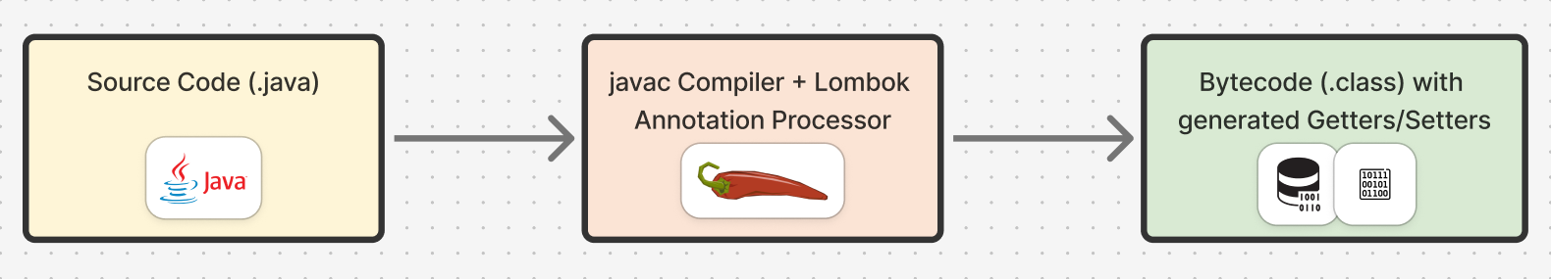
What is Project Lombok?
Annotation-based library that generates common code at compile time
Lightweight • No runtime dependencies • IDE plugin support
Motto: “Spice up your Java.”
Notes:
Lombok hooks into the Java compiler to generate all that routine code before runtime, meaning zero performance cost and cleaner source files.

Slide 5
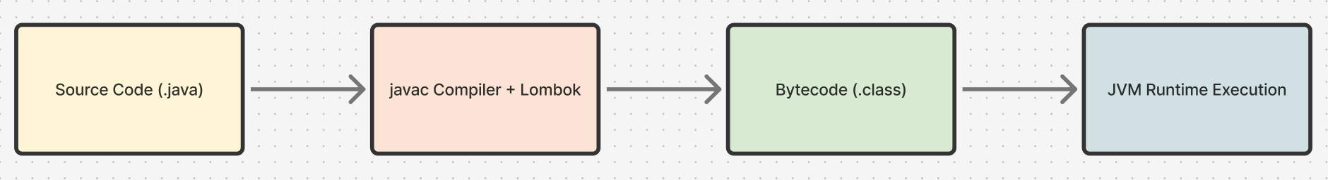
How it works (Compile-Time Only
Annotation processor modifies compiled bytecode
IDE must enable annotation processing
No effect on runtime classpath
Notes:
Lombok’s magic happens before the JVM ever runs the app. This matters because you can treat it as a compile-time dependency—not something shipped in production.

Slide 6
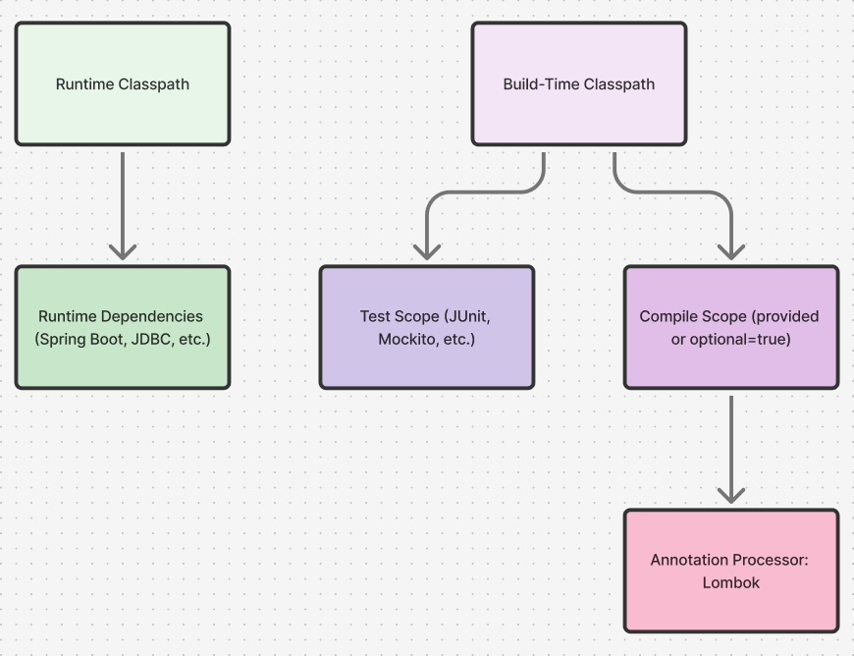
Maven Dependency Scopes
<!-- Recommended enterprise style -->
<dependency>
<groupId>org.projectlombok</groupId>
<artifactId>lombok</artifactId>
<version>1.18.34</version>
<scope>provided</scope>
</dependency>
STILL NEEDS: Visual: small Maven diagram showing build-time vs runtime classpath.
Compare: <optional>true> vs <scope>provided</scope>
Notes:
Both work, but provided makes our intent clearer: Lombok is needed only at compile time. This prevents it from appearing in deployed artifacts—important for clean enterprise builds.

Slide 7
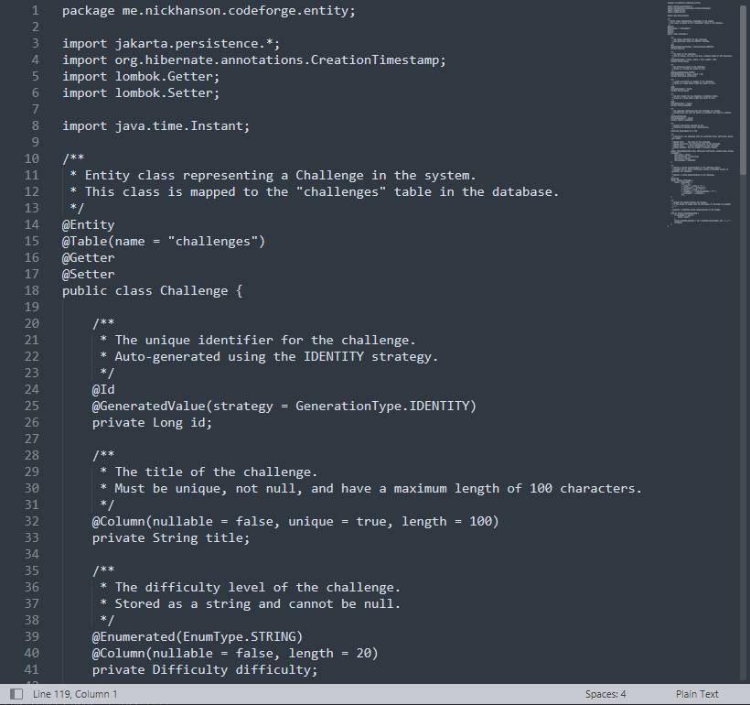
Before Lombok (Manual Version)
Manual constructors, toString(), and documentation comments
~120 lines of repetitive code
Example snippet of old Challenge.java
Notes:
Here’s the original Challenge entity—constructors, getters, and formatting logic everywhere. Functional, but cluttered.

Slide 8
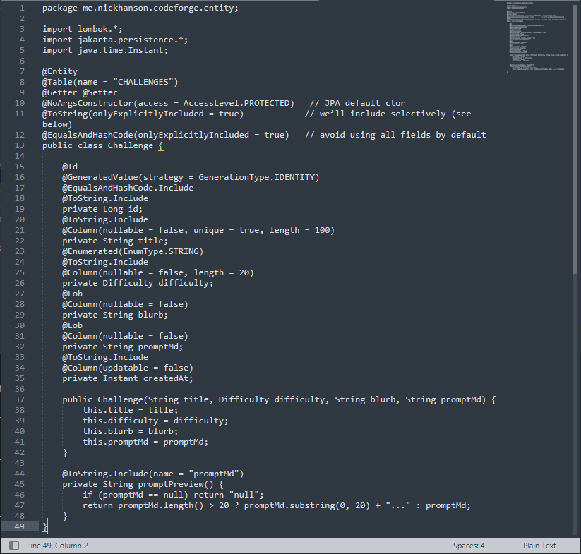
After Lombok (Refactored Version)
@Getter @Setter @NoArgsConstructor @AllArgsConstructor
@ToString(onlyExplicitlyIncluded = true)
Lines reduced → ~120 → ~49
✅ All tests passed
Notes:
After refactoring with Lombok, the same class shrank to 49 lines. Tests still pass, and behavior is identical. The code now highlights intent, not syntax.

Slide 9
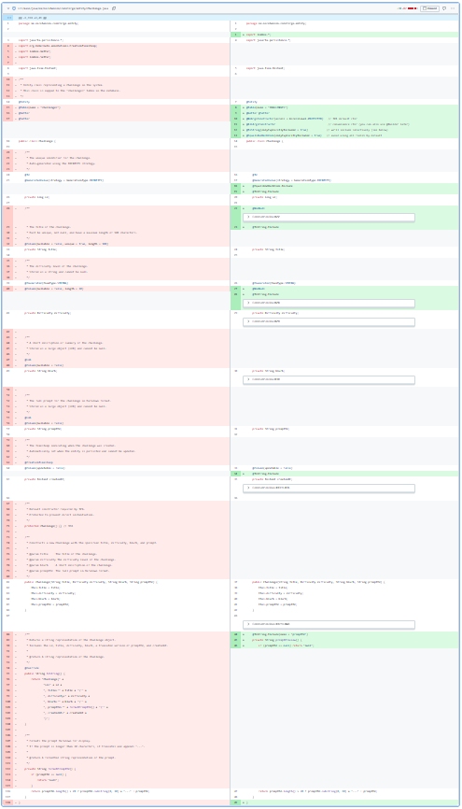

Results & Metrics
Metric | Before | After
Lines of code | 120 | 49
Tests Passing | 37 | 37
Build Errors | Several (fixed) | 0
Readability | Low | High
Notes:
Beyond line count, this simplified diffs, improved readability, and reduced future merge conflict risk.

Slide 10


Gotchas & Fixes
Issue | Fix
Table name mismatch | Added @Table(name = “CHALLENGES”)
Enum insert values | Added @Enumerated(EnumType.STRING)
Lost constructor | Added manual 4-arg ctor
data.sql failed in tests | Enabled spring.jpa.defer-datasource-initialization=true
Notes:
These are natural next steps for future polish: a builder pattern for flexible instantiation and a lifecycle hook to auto-set creation timestamps.

Slide 11
Optional Enhancements: Builder & Lifecycle Hooks
Possible next step:
Add @Builder for fluent object creation
Add @PrePersist hook for automatic timestamping
Used in the Challenge class:
@Builder // ✅ Enables fluent object creation [ . . . ] @PrePersist // ✅ Lifecycle hook void setCreatedAtIfMissing() { if (createdAt == null) createdAt = Instant.now(); }
Instead of:
Used in the ChallengeService class:
@Transactional public Challenge create(ChallengeForm form) { Challenge challenge = new Challenge( form.getTitle(), form.getDifficulty(), form.getBlurb(), form.getPromptMd() ); return dao.save(challenge); }
Challenge c = Challenge.builder() .title("Two Sum") .difficulty(Difficulty.EASY) .blurb("Find two numbers adding up to target.") .promptMd("Given an int array...") .build();
Notes:
These are natural next steps for future polish: a builder pattern for flexible instantiation and a lifecycle hook to auto-set creation timestamps.

Slide 12
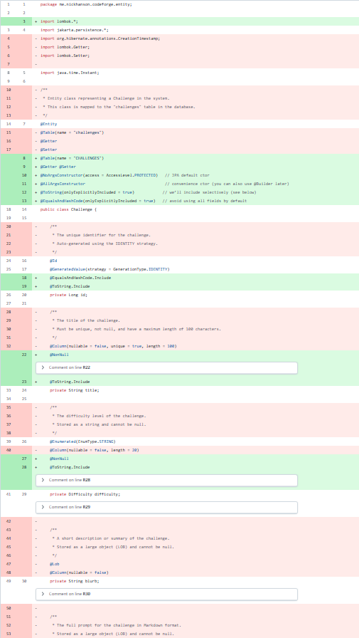
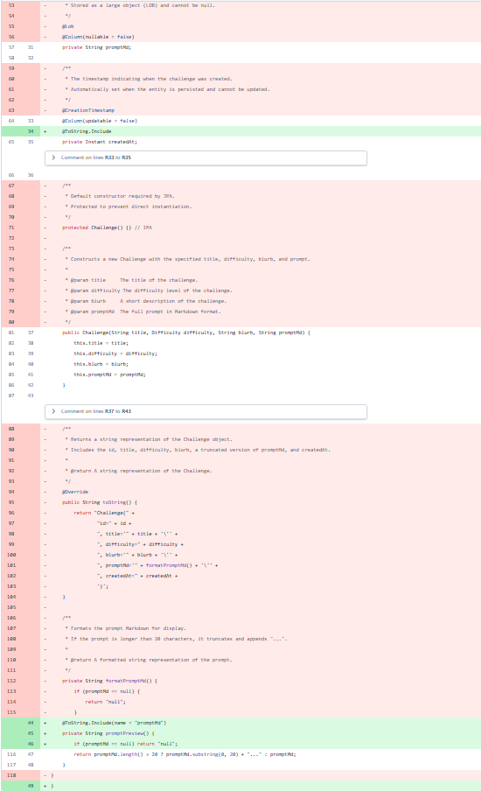


Git Diff
Notes:
Beyond line count, this simplified diffs, improved readability, and reduced future merge conflict risk.

Slide 13


Key Takeaways
Compile-time annotation processing = zero runtime cost
Cleaner entities → easier maintenance
Understanding framework interactions = real enterprise skill
Lombok: Wrangling Java’s spaghetti code since 2009.
Notes:
Using tools safely means understanding how they fit into the build lifecycle. Lombok’s not magic—it’s controlled automation.

Slide 14
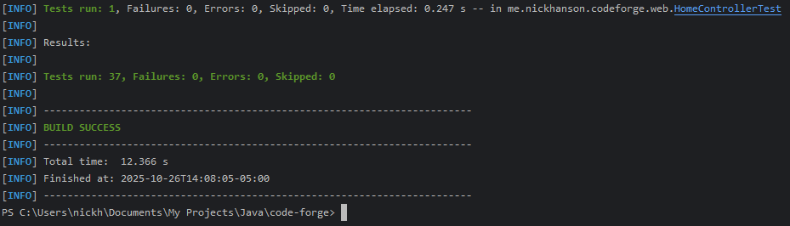
Demo / Verification
Screenshot: test summary “BUILD SUCCESS – All tests passed”
“Functional parity confirmed ✅”
Notes:
Every test passed after refactor, confirming functional equivalence—a perfect example of safe refactoring.

Slide 15


Reflection & Professional Growth
Learned how annotation processing integrates into the Java compiler.
Debugged enum/table mapping & constructor issues
Gained confidence in reading documentation and resolving framework mismatches.
Reinforced best practices for writing clean, maintainable enterprise code.
Strengthened professional presentation and problem-solving skills.
Turning bugs into gains.
Notes:
This project reminded me that mastery comes from understanding how each layer interacts—build tools, frameworks, and annotations—not just writing code that runs.

Slide 16
References & Credits
projectlombok.org
Lombok GitHub repository
Java Persistence API spec (ORM reference)
IntelliJ documentation on annotation processing
All screenshots and code from my CodeForge project.
Notes:
Thanks for watching! Questions are welcome, or feel free to browse the GitHub repo linked in the notes.

